Slide 1
Docker Container Lifecycle Management
The lifecycle of a docker container consists of five states:
Created state
Running state
Paused state/unpaused state
Stopped state
Killed/Deleted state

Slide 2
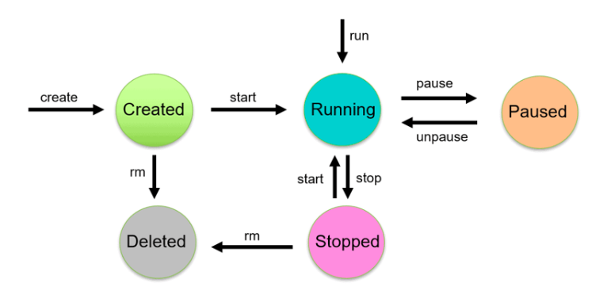

Slide 3
1. Created state:
Using the docker create command will create a new Docker container with the specified docker image.
$ docker create --name <container name> <image name>
Start Container:
To start a stopped container, we can use the docker start command.
$ docker start <container name>

Slide 4
2. Running State:
The docker run command will do the work of both “docker create” and “docker start” command.
This command will create a new container and run the image in the newly created container.
docker run <container-id>
or
docker run <container-name>
or
$ docker run -it --name <container name> <image name>

Slide 5
3. Paused state :
The current executing command in the docker container is paused.
Use the docker pause command to pause a running container.
$docker pause container <container-id or container-name>
Note: docker pause pauses all the processes in the container. It sends the SIGSTOP signal to pause the processes in the container.

Slide 6
4. Unpaused state
In the unpaused state, the paused container resumes executing the commands once it is unpaused.
$docker unpause <container-id or container-name>
Docker sends the SIGCONT signal to resume the process.

Slide 7
5. Stopped State:
In the stopped state, the container’s main process is shutdown gracefully.
Docker sends SIGTERM for graceful shutdown
$docker stop <container-id or container-name>

Slide 8
6.Kill State:
In the killed state, the container’s main processes are shutdown abruptly.
Docker sends a SIGKILL signal to kill the container’s main process.
$docker kill <container-id or container-name>

